Slide 1
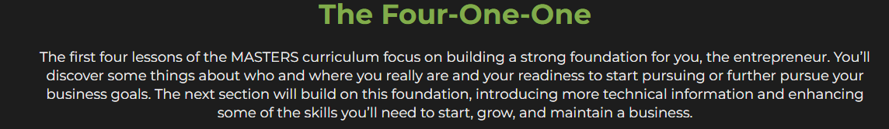

Slide 2


Slide 3

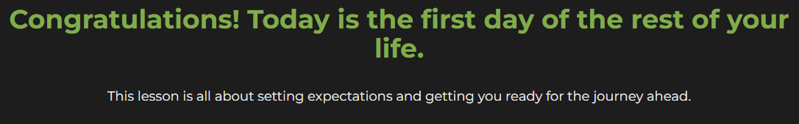

Slide 4
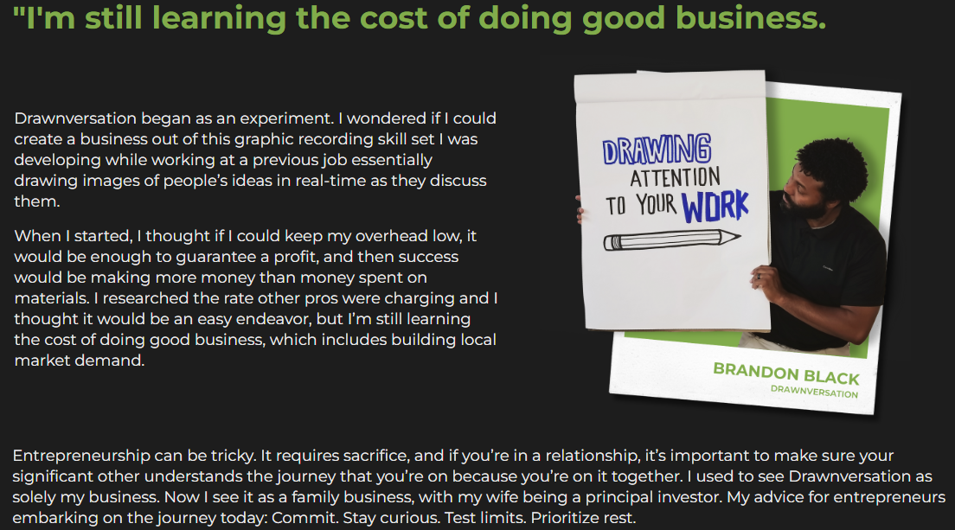

Slide 5
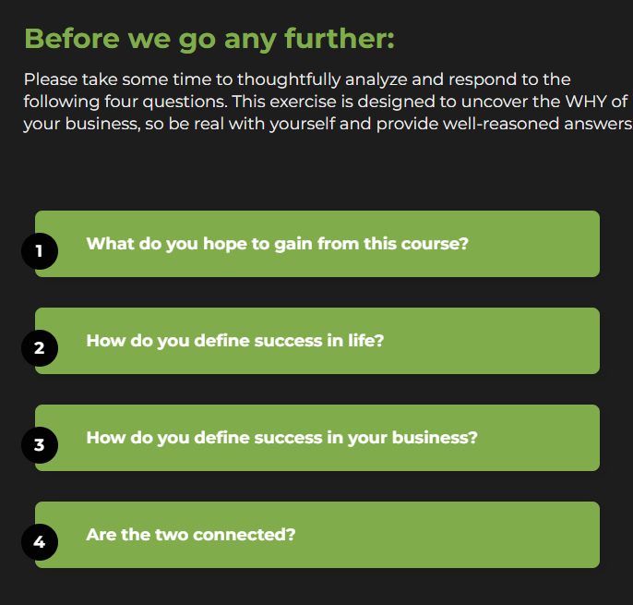
Survey

Slide 6
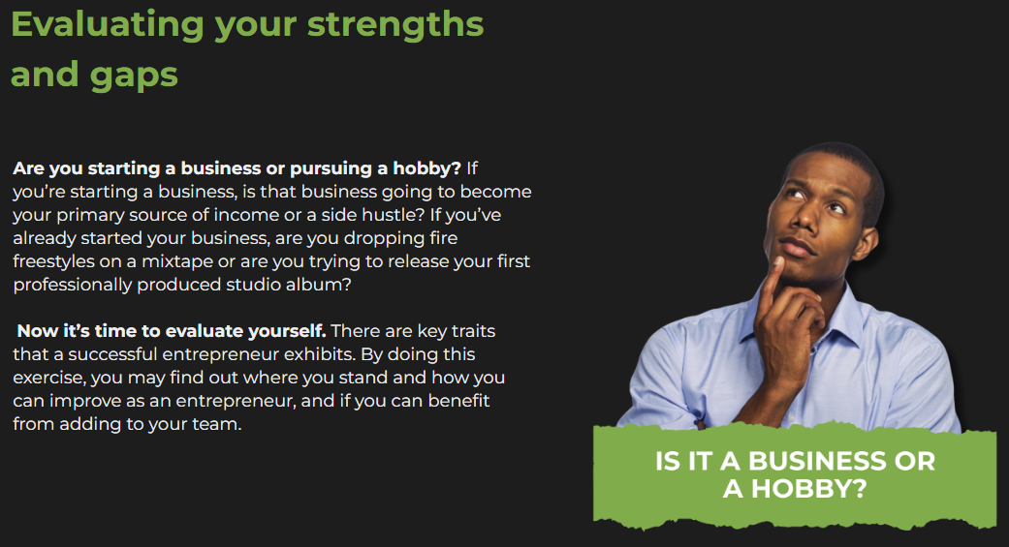

Slide 7
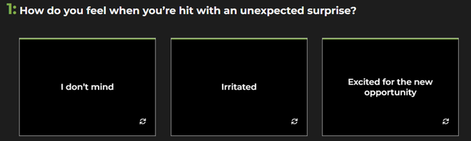
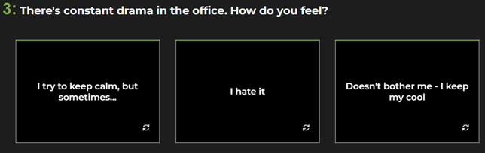
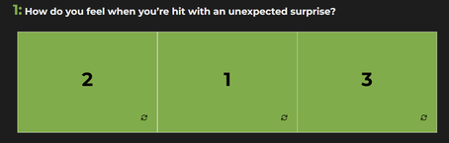
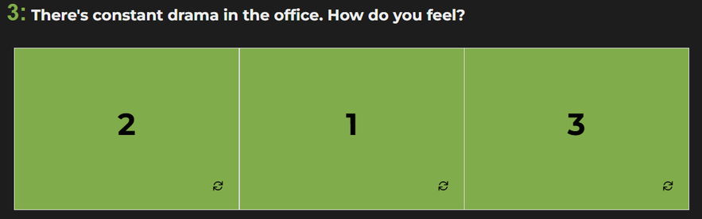
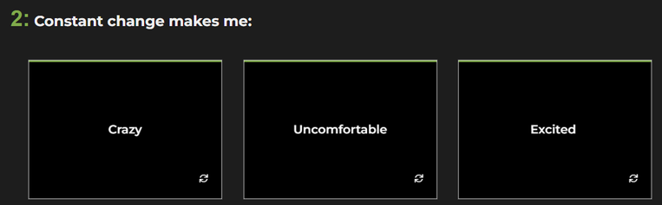
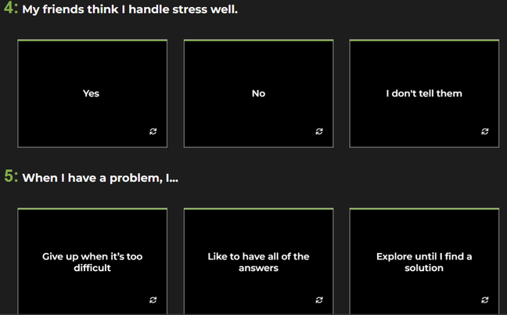
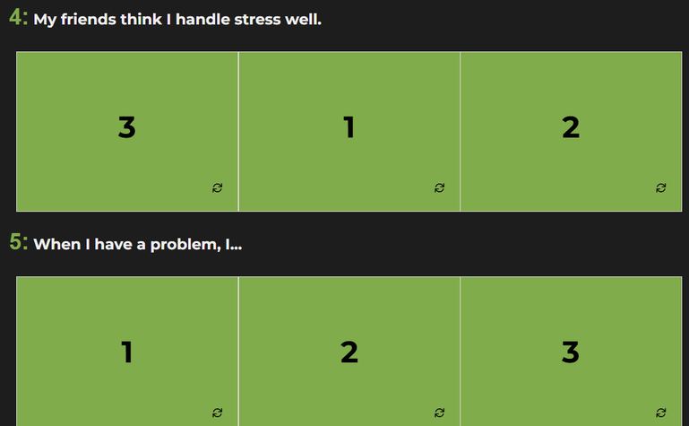
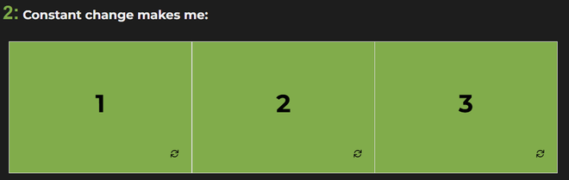
Survey

Slide 8
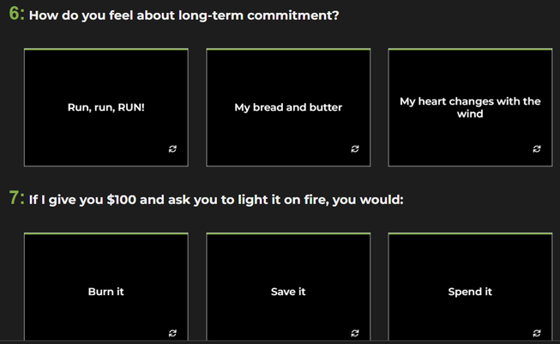
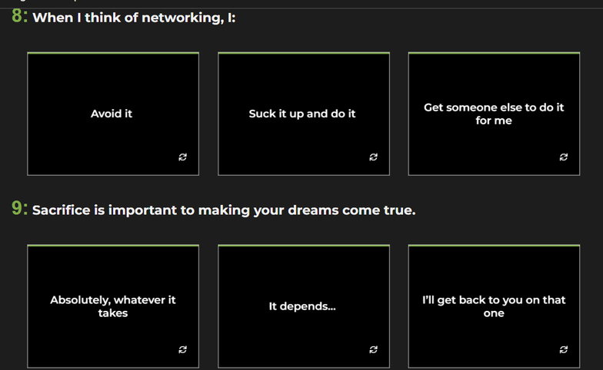
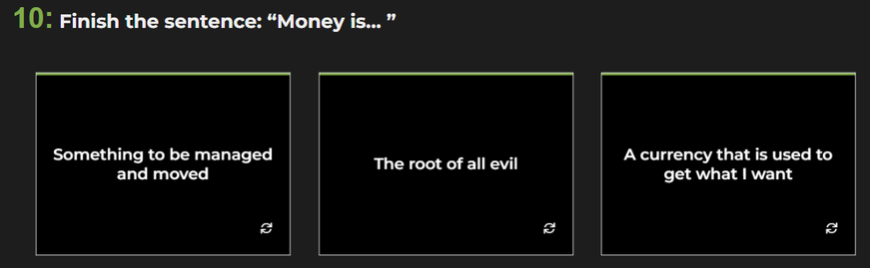
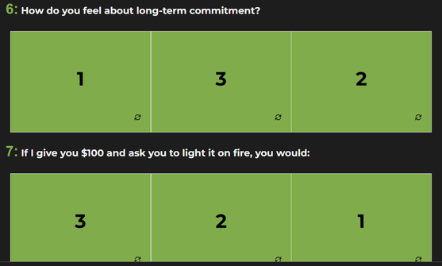
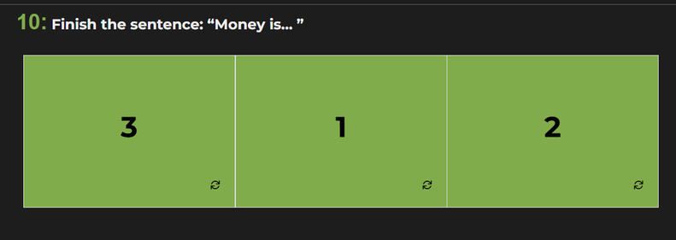
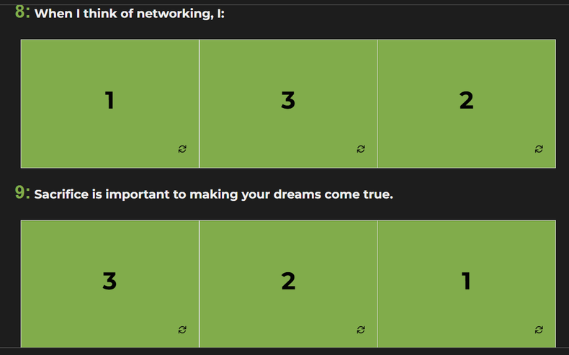
Survey contd.

Slide 9


Slide 10
23-30
Entrepreneurship is in the cards!

Slide 11
16-23
You can get there, but it won’t be easy.

Slide 12
16 and below
We aren't saying that being an entrepreneur will be impossible for you, but statistically, it may be more challenging than you may have originally expected… make sure that you really put your whole heart into it or entrepreneurship may be challenging for you.

Slide 13

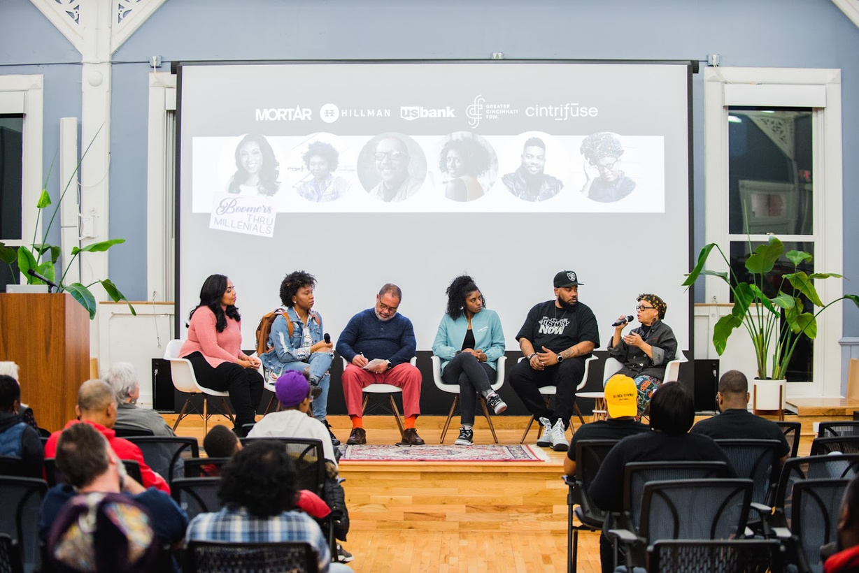

Slide 14
In this video, a group of MORTAR Alumni share their biggest challenges as entrepreneurs and how MORTAR is set up to respond to those challenges. Sit back and take notes

Slide 15
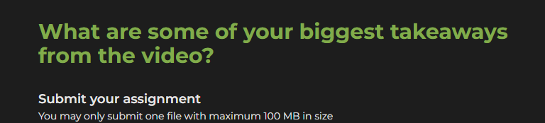
Survey

Slide 16
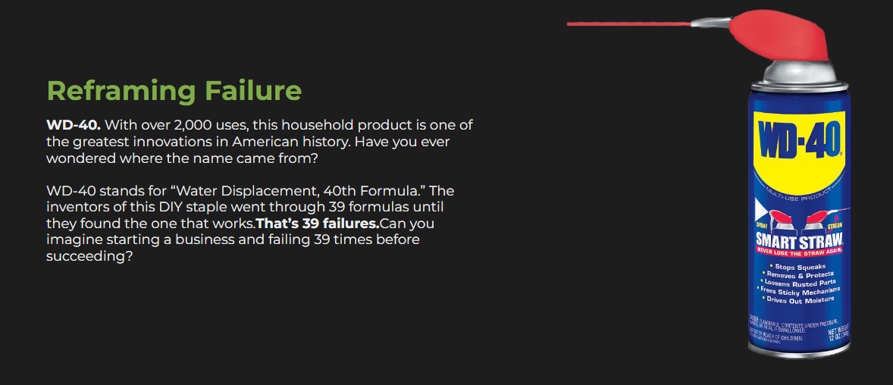

Slide 17
Survey
Think about it:
What does failure mean to you now that you’ve had a chance to think about it?
What have you learned from the failures in your life?
Submit your assignment
You may only submit one file with maximum 100 MB in size

Slide 18
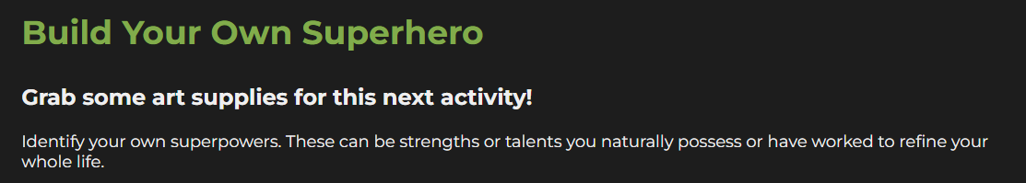

Identify your kryptonite. These can be gaps you need to work on or skills you need to develop. Use art supplies to create your superhero logo. Create your superhero squad. This can include friends, family, and mentors. What is your squad’s name? How will you work together?

Slide 19
Survey
Think about it:
Has your definition of success and failure changed at all?
What does success look like now, personally and for your business?
What does failure look like now, personally and for your business?
Submit your assignment
You may only submit one file with maximum 100 MB in size

Slide 20
Quiz
According to panelist, Donny Harper, from this lesson’s panel discussion, the best way to manage expectations is by:
Choose only ONE best answer.
A
Setting clear business goals and being flexible
B
Don’t have any!
C
Make sure expectations are low so that you don’t let yourself down
This answer is correct.
True or false: Success looks the same for everyone
Choose only ONE best answer.
A
True - Everyone wants to make lots of money!
B
False - Everyone can have their own definition of success
This answer is correct.
Who can you reach out to for support in building your business?
Choose only ONE best answer.
A
Friends, family, community members, and professionals
B
No one! It’s all on me!
This answer is correct.

Slide 21
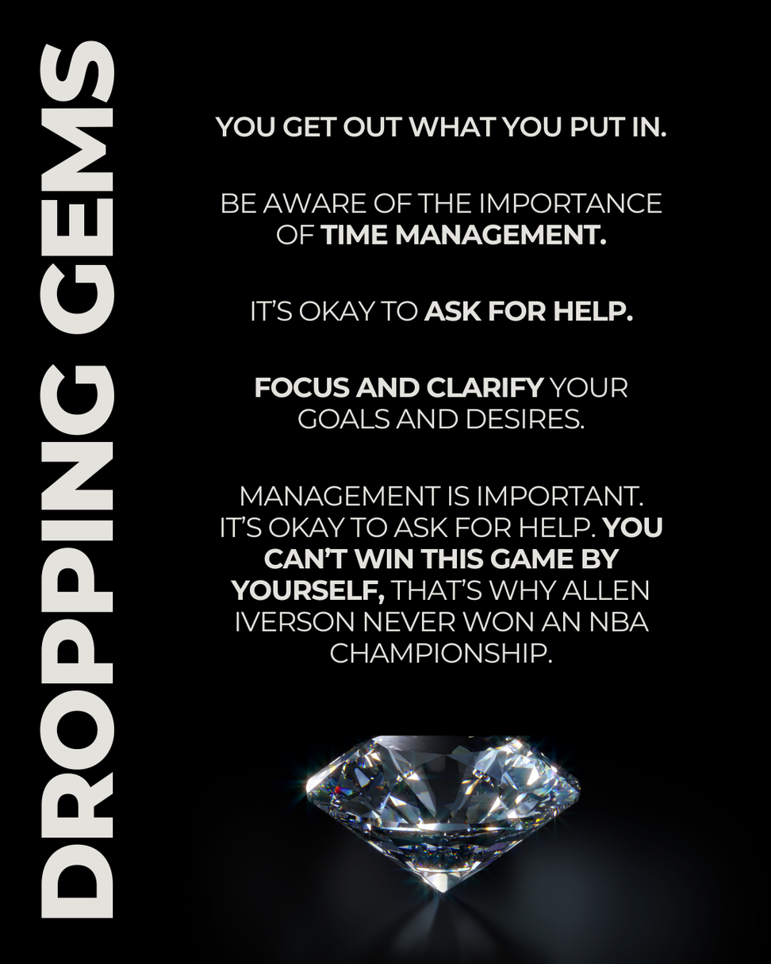

Slide 22
